Slide 1



Speech Denoising with Noise2Noise model
Capstone Project Phase B
Students:
Omri Cohen
Eliav Shabat
Supervisors:
Dr. Renata Avros
Prof. Zeev Volkovich
Rafael supervisor: Eli Hundia

Slide 2
TABLE OF CONTENTS
01
02
03
04
05
06
INTRODUCTION
REQUIREMENTS
WORKING METHODOLOGY
RESULTS
CHALLENGES
THE SOLUTION
Notes:
Omri

Slide 3




01
INTRODUCTION

Slide 4
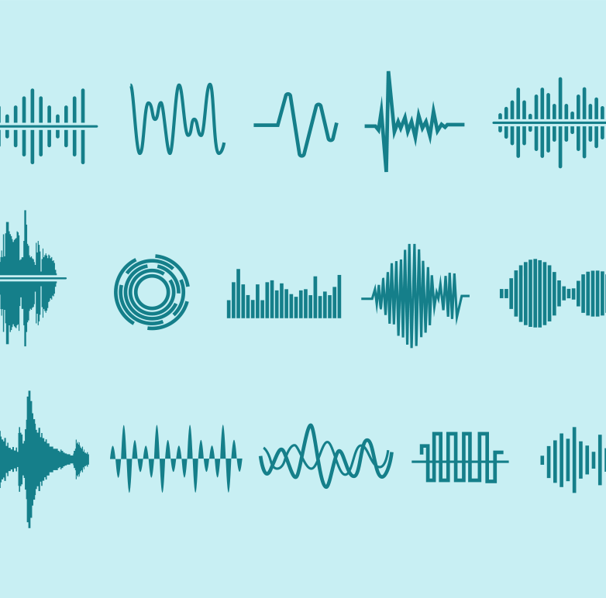
THE PROBLEM
Disturbance and noise in military communications: Military radio communications often suffer from background noise, including static and interference noise.
Poor quality leads to poor performance: Difficulty understanding recordings that can be used as intelligence information tasks.
Challenges in Speaker recognition: Complicates the task of speaker recognition. Crucial for effectiveness in defense tasks.
Notes:
Omri
Radio communications in warzone often suffer from background noises. White noise, gunshot, people, rockets.
It makes analyzing difficult. In different defense tasks. Translation, speech recognition.
Focus on speech recognition for RAFAEL systems and specific radio communication.

Slide 5
THE NEED?
Lack of Existing Solutions: Traditional noise removal techniques typically depend on the availability of clean data during the training stages. However, these methods are inadequate for real-world scenarios.
Operational Needs: Clear and reliable audio is essential for tactical operations where effective communication significantly contributes to success, especially in mission-critical situations.
Potential for Future Applications: Implementing this denoising solution could benefit companies like RAFAEL by enhancing the performance of models in future applications such as speaker recognition and speech-to-text. As audio clarity improves, these technologies become more accurate
Notes:
Eliav
What are the needs for our solutions?
Lack of existing solutions: Traditional noise removal techniques depend on the availability of clean data during training stage; However, such data is not always available in real world scenarios. That’s why we are using model that is trained on noisy inputs and targets.
Operational needs: clear and reliable audio is essential for tactical operations, bad communication can often lead to failures in mission-critical situations
Potential for future applications: Good and reliable solution for denoising can become very useful in future applications such as – speaker recognition, speech-to-text models and more…

Slide 6
02
REQUIREMENTS

Slide 7
REQUIREMENTS
Denoising
Speaker's voice
SNR
The system should be capable of denoising military radio communications to enhance speech clarity and intelligibility.
The system must be capable of denoising without distorting the speaker's voice
The system should achieve improvement of at least 10dB in SNR
Varied Data
API Documentation
Adaptability to Noise Types
The system must handle a variety of noise types, including those unique to military operations and equipment.
The system must support data scaling to handle larger datasets for training
The system must include documentation for future programmers and users.
Notes:
Omri
Denoise radio communication recordings
Not distorting speaker voice
Signal to noise ration to understand the difference between noise and speech. Need 10 dB
Because each recording can have different noise need to be adaptable
For various kind of training on different radio and noise need to support different datasets
For another users and programmer document

Slide 8
03
WORKING METHODOLOGY

Slide 9




WORKING METHODOLOGY
2. Dataset Preparation and System Design
1. Research and Planning
Initial theoretical research involved collaborating with RAFAEL to select suitable machine learning architectures and reviewing literature to understand audio denoising.
Develop various scripts to create and process noisy datasets mimicking military radio interference, develop the system around the Deep Complex U-Net architecture using Noise2Noise approach.
3. Model Training and Testing
4. Evaluation and Iteration
The model's performance was continuously evaluated and optimized through finetuning. Aiming to meet predefined benchmarks such as improved SNR and clear audio output.
Training involved iterative model adjustments and testing with various noised datasets to enhance model's ability to discern noise from speech.
Notes:
Omri
1. **Research and Planning**: The project began with a theoretical exploration of various machine learning architectures that excel in handling audio signals. The team collaborated with RAFAEL to define the project's scope and chose the U-Net architecture in combination with the Noise2Noise method, which allows for effective training without clean audio data. This phase also included a review of academic literature and other resources to better understand the denoising process and the tools needed for implementation.
2. **Dataset Preparation and System Design**: The team developed scripts for creating, merging, and processing datasets to simulate different noise levels and types that are common in military radio communications. The core system architecture was based on the Deep Complex U-Net model, which is particularly suited to processing complex-valued audio data and improving key quality metrics like Signal-to-Noise Ratio (SNR) and Perceptual Evaluation of Speech Quality (PESQ).
3. **Model Training and Testing**: Practical research included the generation of various noisy datasets using scripts and third-party software, with iterative adjustments to the model based on the training results. The model was trained using these datasets, focusing on the enhancement of SNR and the overall intelligibility of speech. This phase was crucial for refining the model to effectively reduce noise while maintaining the quality of the original audio signals.
4. **Evaluation and Iteration**: After initial testing, the project moved towards optimizing the model by adjusting neural network parameters and training strategies. The final outcomes were evaluated against project benchmarks like improvement in SNR and the clarity of denoised audio samples. Challenges such as resource constraints and the learning curve associated with audio processing were addressed through continuous learning and improvements in the computational setup (e.g., transitioning from local machines to AWS EC2 instances).

Slide 10
04
SOLUTION

Slide 11





TOOLS
+
+
VS Code with Git
Cloud Computing
Software and Libraries
Utilized Visual Studio Code with Git integration for code management, ensuring flexibility and consistency across different machines.
Started on local machine equipped with WSL (Ubuntu) and NVIDIA RTX 4070ti GPU. Later we shifted to AWS EC2 for more scalable resources, utilizing Tesla T4 GPUs to handle intensive model training.
Utilized torch for neural network operations, torchaudio for audio processing, and CUDA for GPU acceleration.
Notes:
Eliav
There are 3 main tools used throughout the development process that helped us:
Visual Studio Code with GIT: Utilizing visual studio code with git integration for code management – ensuring flexibility and consistency across different machines.
Cloud computing: Started on local machine equipped with WSL with ubuntu image (Windows Subsystem for Linux) and Nvidia RTX 4070 with 12GB of VRam. We shifted to AWS Elastic Compute 2 (denoted as EC2) for more scalable resources, utilizing Tesla T4 GPU with 16GB of VRam to handle the training.
Software and Libraries Utilized torch for neural network operations, torchaudio for audio processing and CUDA for GPU acceleration.

Slide 12
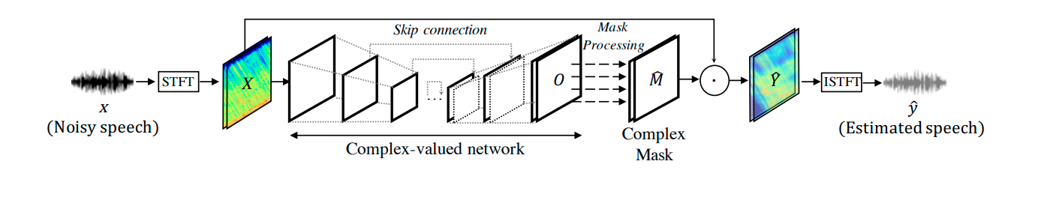
ARCHITECTURE
The Original U-Net:
Designed originally for image segmentation.
Symmetrical architecture contains encoders and decoders.
Includes skip connections that enhance the accurate placement of image features in segmentation tasks.
The Modified U-Net:
Extends U-Net to include 20 layers, designed to handle complex data efficiently.
It adopts the Noise2Noise approach - uses noisy inputs and targets in training stage and by that eliminating the need for clean audio samples.
The original U-Net
Notes:
Eliav
In order to achieve a good Denoising model we choose to relay on U-Net architecture.
The original U-Net architecture is Designed originally for image segmentation.
It has symmetrical architecture containing encoders and decoders
It Includes skip connections that enhance the accurate placement of image features in segmentation tasks. The skip connections preserve information from earlier in the process (in earlier layers) and help to ensure that crucial data isn't lost as it passes through successive layers
The Convolutional Neural Network (CNN) we use in our project is a modified version of the original U-Net, it’s called DCU-Net.
DCU-Net Extends U-Net to include 20 layers, designed to handle complex data efficiently.
It adopts the Noise2Noise approach - uses noisy inputs and targets in training stage and by that eliminating the need for clean audio samples.
Contracting Path (Encoder): Consists of convolutional and pooling layers to reduce spatial dimensions while increasing feature depth, capturing the context of the input.
Expansive Path (Decoder): Comprises upconvolutional and convolutional layers to expand spatial dimensions and reconstruct the image from the compressed features, aiming for precise localization. This path often uses skip connections from the contracting path to enhance detail and accuracy in the output.

Slide 13
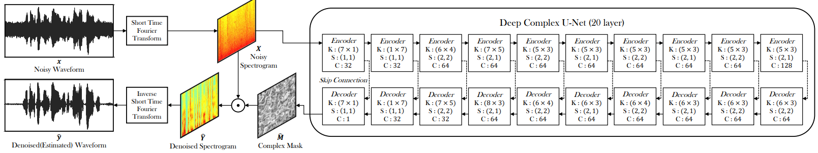
ARCHITECTURE
Our Deep Convolutional Network (DCUnet-20)
Notes:
Eliav
As you can see, we have 20 layers (10 encoders and 10 decoders) each layer has it’s own kernel, stride and channel sizes.
The kernel sizes in convolutional neural networks (CNN), particularly in the context of processing audio signals represented as spectrograms, have an impact on how the model captures and processes temporal and frequency information.
Understanding Kernel Sizes:
(7, 1) Kernel: This kernel has a larger size in the time dimension and is narrow in the frequency dimension. It's designed to capture longer temporal patterns without mixing too many frequency components. This can be useful for identifying features that spread across time but are narrow in frequency, such as a buzz sound or a tone.
(1, 7) Kernel: Conversely, this kernel is elongated in the frequency dimension, which means it can capture wider frequency patterns while keeping temporal resolution high. It can help the model to identify features that are stable over time but vary across frequencies, like the sound of a chord.
Rectangular Kernels (e.g., (6, 4), (7, 5)): These kernels are neither too stretched in time nor frequency, allowing the model to learn features that have some extension in both dimensions. They can be useful for capturing the characteristics of speech or other complex sounds that vary in both time and frequency.
Square Kernels (e.g., (5, 3)): Square or almost square kernels capture information more uniformly across time and frequency dimensions. They are versatile and can be used to learn a variety of features.

Slide 14
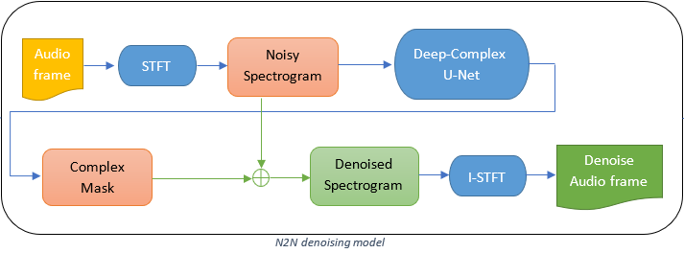
AUDIO PROCESS
Notes:
Omri
Short time furrier transform from time domain to frequency domain
Run spectrogram on model
Invers stft

Slide 15
DEVELOPMENT PROCESS
Data generation: Implementation of Gui and python scripts to create various datasets for training. Updated according to results of trainings.
Train Using Noise2Noise Approach: Implement training directly on noisy data inputs without requiring clean audio samples.
Convert Speech to Spectrograms: Transform audio inputs into frequency domain representations for detailed analysis.
Utilize Deep Complex U-Net (DCUnet-20): Process complex spectrogram data using an advanced neural network architecture.
Employ SNR and PESQ During Training: Optimize model according to SNR and PESQ, audio files, waveforms and spectrogram.
Notes:
Omri
Implement Gui, scripts, updated
Training infrastructure to train the data
Convert speech to spectrogram
Adjust model to handle the inputs
Update using results

Slide 16
05
RESULTS

Slide 17


METRICS FOR EVALUATION
Human Hearing
We analyzed the recordings by listening to them both before and after processing through the model. This initial assessment provided a preliminary indication of the training's effectiveness. Most of the tests were passed successfully, with significant noise reduction observed in the recordings.
SNR
Signal-to-noise ratio (SNR) is a measure that compares the level of a desired signal to the level of background noise. We aimed for a minimum 10dB improvement in SNR. Results varied, with some samples notably exceeding the goal and others, especially ones with poorer quality, showed smaller gains.
Notes:
Eliav
In order to evaluate the results we used several metrics:
Human hearing: We analyzed the recordings by simply listening to them – before and after the denoising process (before passed them through the network). Most of the tests were passed successfully and the tests who didn’t were often too noisy to understand even for human ear.
SNR: A common way to assess audio quality is Signal-to-Noise Ratio (denoted as SNR). We aimed to improve the SNR by at least 10db. The results were varied, some of them were notably better than our goal and others (especially ones with poorer audio quality), showed smaller gains.

Slide 18

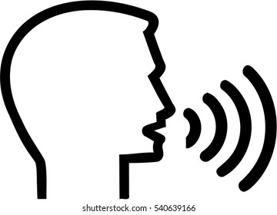
METRICS FOR EVALUATION
Visual Assessment
Conducted visual comparisons of the Noisy and Denoised spectrograms, as well as between Denoised and the Original (clean) spectrograms. Most assessments indicated good results and sufficient similarity to the original clean samples.
Perceptual Evaluation of Speech Quality (PESQ)
PESQ measures the clarity and quality of speech after processing. In our tests, speech improvements were minor, highlighting an area for further development. Consider to focus on enhancing this metric in future iterations to improve overall model performance.
Notes:
Eliav
Visual Assessment: We conducted visual comparisons of the (noisy vs. denoised) and also (denoised vs. original) spectrograms. Most assessments indicated good results and sufficient similarity to the original clean samples.
Perceptual Evaluation of Speech Quality (PESQ): PESQ measures the clarity and quality of speech after processing. Our goal was to remove noises from the audio samples while maintaining the speech quality, something we have done quite successfully . In our tests we have found that speech was preserved but the improvements were minor – something that worth to focus on future iterations in order to improve overall model performance.

Slide 19

RESULTS
Audio - Denoised audio on a scale of 1-10
Diagram - waveforms on a scale of 1-10
SNR – measured in dB units
PESQ - score between -0.5 and 4.5
 | Audio | Diagram | SNR | PESQ
TRAIN 1 - 20000 samples Only White noise | 8 | 9 | Min: 4.423dB Max: 20.935dB Mean + STD: 13.617+/-5.245 | Min: 1.219 Max: 2.719
TRAIN 2 – 7000 samples with radio noise added using audacity | 3 | 3 | Min: -6.231dB Max: 0.081dB Mean + STD: -3.03+/-2 | None
TRAIN 3 - 23000 samples with different noises added using python library – EPOC 1 | 8 | 7 | Min: -4.684dB Max: 21.242dB Mean + STD: 3.945+/-5.631 | Min: 1.016dB Max: 3.256dB
TRAIN 3 - 23000 samples with different noises added using python library - EPOC 4 |  |  | Min: -3.855dB Max: 22.435dB Mean + STD: 4.335+/-5.670 | Min: 1.019dB Max: 3.403dB
Noisy gun
denoised gun
Notes:
Omri
Initial understanding of abilities and denoising
Train to handle radio communication
Train to handle various noises and al lot of samples

Slide 20
Train 3 - Example
The data set contains 23,000 samples. Each sample consisted of a speech segment noised with a different noise (radio communication, white noise, gunshots, etc.).
Results of denoise a recording that includes an English speaker with train stops noise in the background:
Initial SNR between noisy and clean recordings: -1.119dB
Improved SNR after denoising process between denoised and clean recordings: 10.005dB
Improvement of 11.124dB
Noisy
denoised
Notes:
Omri

Slide 21
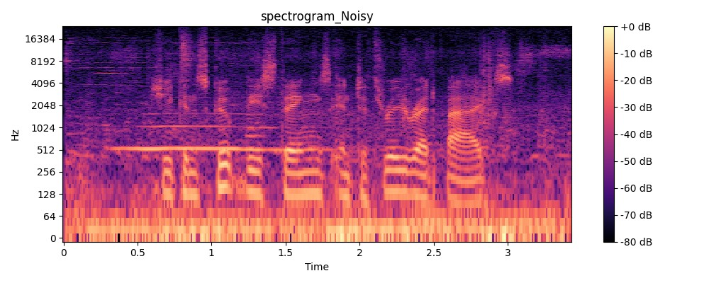
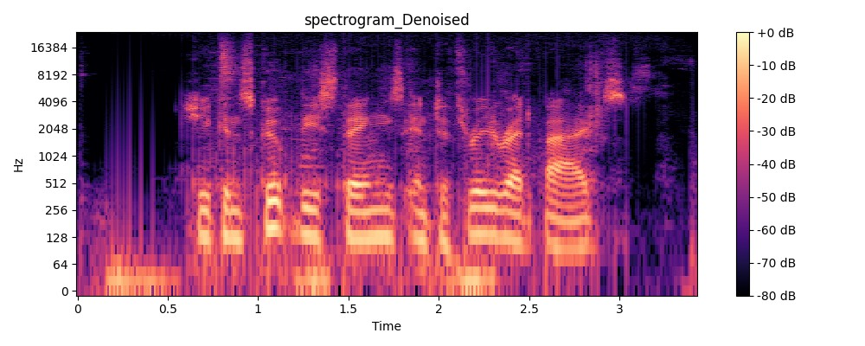
Spectrograms
Figure 18 Noisy audio recording spectrogram
Figure 19 Denoised audio recording spectrogram – The black parts are the denoised areas. Most of the noise removed successfully
Notes:
Omri
Noise at start of recording
Black areas denoised
Speech is the bright areas

Slide 22
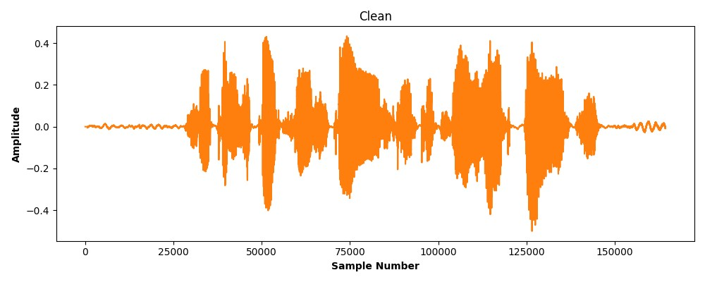
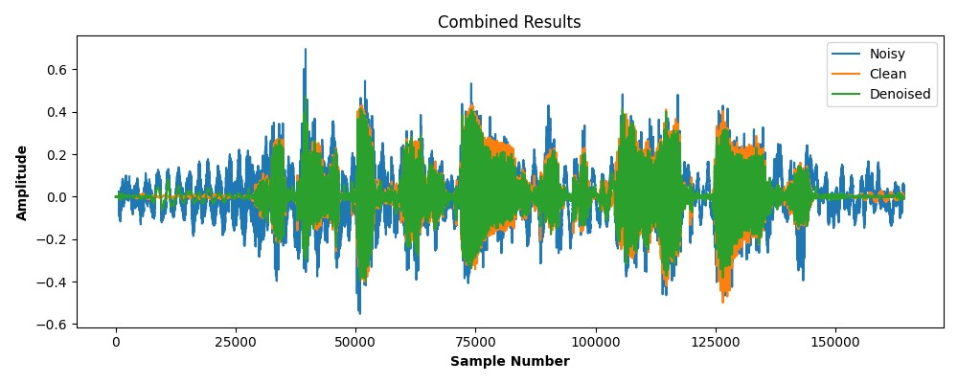
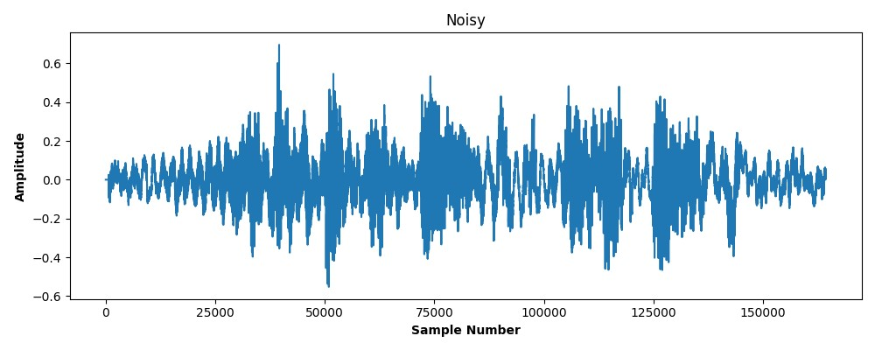
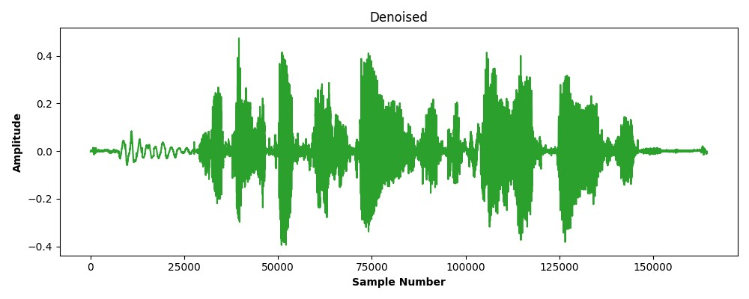
Waveforms
Figure 20 Clean waveform
Figure 20 Noisy waveform
Figure 22 Combined waveforms - The denoised waveform (green) closely follows the clean waveform (orange) indicating successful denoising (blue)
Figure 21 Denoised waveform
Notes:
Omri
Clean
Noisy train and speech
Denoise aim to mimic clean
Result blue is removed

Slide 23
06
CHALLENGES

Slide 24
CHALLENGES
Lack of Audio Expertise
Data Quality and Volume
Our initial unfamiliarity with audio processing, particularly concepts like SNR and noise characteristics, posed a steep learning curve and required extensive research and consultation to overcome.
Acquiring a sufficient volume of high-quality, diverse audio samples required robust pre-processing to standardize data for effective training.
Hardware Limitations
Dependency Management
Initial struggles with computational constraints on local setups led to a shift to AWS EC2 with Tesla T4 GPUs for enhanced processing capabilities.
Consistency in library versions across different environments was crucial to avoid unexpected behaviors during model training and evaluations.
Notes:
Eliav
Through developing the model and working on this project we faced several challenges:
Lack of Audio Expertise: We don’t familiar with the world of Audio and the terms in the field This is something that required us to do some studies and self-learning in order to get better understanding of the data we need to work with and to be able to improve the model performance.
Data Quality and Volume We needed to create a sufficient size of audio samples and pre-process it to fit our model requirements. To face this challenge, we needed to automate the process of adding noises and labeling the data, so we have created python scripts and utilized them to our purposes.
Hardware Limitations: Started working with home computer using the local GPU hosted on. It took us a serious a amount of time so after servel weeks we searched for a good cloud platform, we chose AWS and deployed our git repository into it, did all the installations and started training with AWS machine (using Tesla T4 GPU).
Dependency Management: When we shifted from local computer into Cloud platform we needed to install everything from the beginning. To face that challenge successfully we used a `Requirements` file that contains all the necessary python packages and libraries to our project.

Slide 25
Future work
Potential Future Enhancements for Communication Systems
Model Integration with Walkie-Talkies: Combine the model into existing systems to perform Real-time Denoising.
Enhanced Speech Quality: Add layers to improve speech clarity.
Automated Dataset Generation: Develop a system for automated data collection and labeling within the existing communication systems.
Notes:
Eliav
Integrate Model with Walkie-Talkies: Combine the model into existing systems to perform Real-time Denoising.
Model Improvements for Speech Quality: Modify the model by adding layers to specifically enhance speech clarity and not just noise removal.
Automate Dataset Generation: Develop a pipeline to automate data collection and labeling from current communication systems, which enables training on larger audio sample sets to improve audio denoising results.

Slide 26
Thanks for listening

